Slide 1
Digital Portfolio
STUDENT NAME:S.VIGNESH KUMAR
REGISTER NO AND NMID: 222404573/asunm130124j013
DEPARTMENT: Bsc .Software Application
COLLEGE: COLLEGE/ UNIVERSITY :A.M JAIN COLLEGE

Slide 2
PROJECT TITLE
DIGITAL
PORTFOLIO
DIGITAL

Slide 3


AGENDA
Problem Statement
Project Overview
End Users
Tools and Technologies
Portfolio design and Layout
Features and Functionality
Results and Screenshots
Conclusion
Github Link
3/21/2024 Annual Review

Slide 4

PROBLEM STATEMENT
Building The structure
Giving Perfect Colors
3 ) Inserting pictures
4) Making Scrolling smooth
5) Making it Responsive

Slide 5

PROJECT OVERVIEW
A Digital Portfolio fully attac hed about my skills in the software world and also it holds my project
i have linked my github , linkedin ,Twitter profile

Slide 6

WHO ARE THE END USERS?
The Companies I go for Interview My Online Clients

Slide 7

TOOLS AND TECHNIQUES
HTML
css
JAVASCRI PT

Slide 8
POTFOLIO DESIGN AND LAYOUT
It has a maginificent Purple blended violet colors and it has my profile photo , My name in the Starting
after scrolling down you can find my projects , and what Skills do i have and lastly you got a information box
to fill up your details and get in touch with me...
- Thank you!!
8

Slide 9
FEATURES AND FUNCTIONALITY
Displays My Essential Details
Scrolls Smootly
it has a Arrow button in the left to scroll up from down

Slide 10
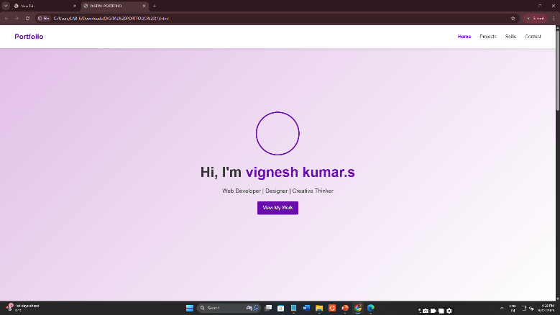
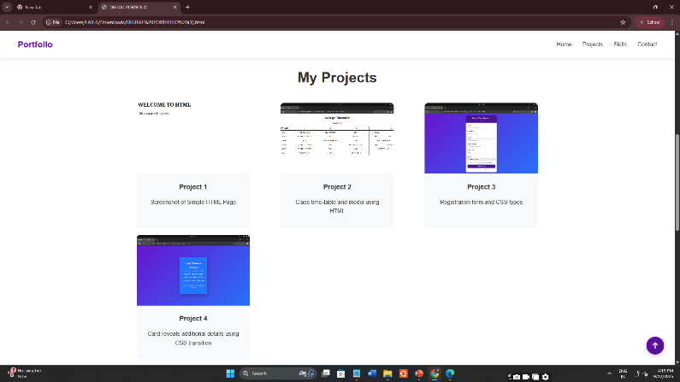

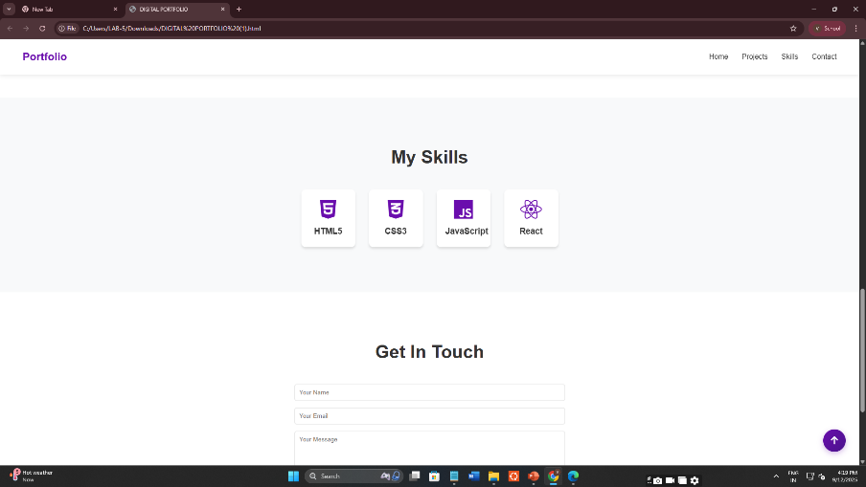
RESULTS AND SCREENSHOTS
3/21/2024 Annual Review
10

Slide 11
CONCLUSION
I have created this Portfolio with my Hardwork and
consistency
Githublink: https://vigneshkumar2006290.github.io/TNSDC-FWD-DigitalPortfolio/
Server link:https://github.com/vigneshkumar2006290/TNSDC-FWD-DigitalPortfolio.git
11

